Slide 1

Making sense of records

Slide 2
The story process
The idea
Research
Questions
Interviews
Sorting
What is the story?
What will help tell the story?
Flow
Fairness
Accuracy

Slide 3
Questions: When you receive documents
Return to your original notes and re-familiarize yourself with the issues
Go through the documents carefully in a quiet space and make notes

Slide 4
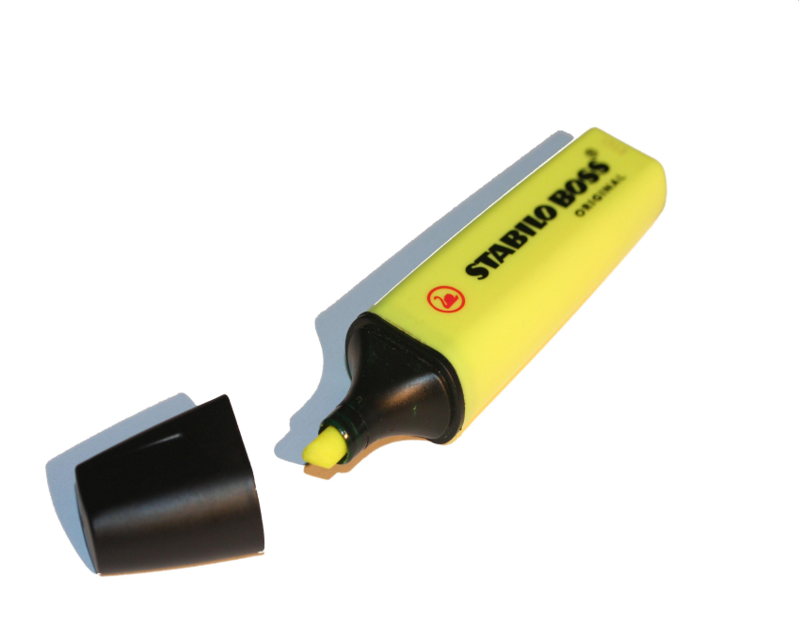


Instead of highlighting text, write notes in the margins

Slide 5
Questions: Decoding
Deciphering access records is a little like reading tea leaves: They are often a jumble, littered with strange acronyms and blacked-out (or whited-out) paragraphs, and lack titles, dates and information about who created the documents.
As you make notes, look up unfamiliar words and names.

Slide 6
Questions: decoding (or interviewing the data)
Page of emails from Transport Canada released under the Access to Information Act

Slide 7
Decoding the Transport Canada document
tc.gc.ca = Transport Canada e-mail address
John Forster = Associate Assistant Deputy Minister Safety and Security, Transport Canada, Safety and Security Group, Tel. (613) 949-2394
CIA = U.S. Central Intelligence Agency
CSIS = Canadian Security Intelligence Service
GMT = Greenwich Mean Time
Time in Greenwich, England, which is used as the basis of standard time throughout the world.
CACO = Civil Aviation Contingency Operations
Role: Managing and operating a 24 hour/day Aviation Operations Centre including an aviation reporting system involving the tracking of aviation related incidents, accidents and high profile events for the purpose of keeping senior managers appraised of operations in the National Civil Air Transportation System
Navcan = Nav Canada
Nav Canada co-ordinates the safe and efficient movement of aircraft in Canadian domestic airspace and international airspace assigned to Canadian control. Through its coast-to-coast operations, NAV CANADA provides air traffic control, flight information, weather briefings, aeronautical information, airport advisory services, and electronic aids to navigation.

Slide 8
Questions: Chronology
Creating a timeline of events can help patterns emerge and assist you in determining what the story is

Slide 9
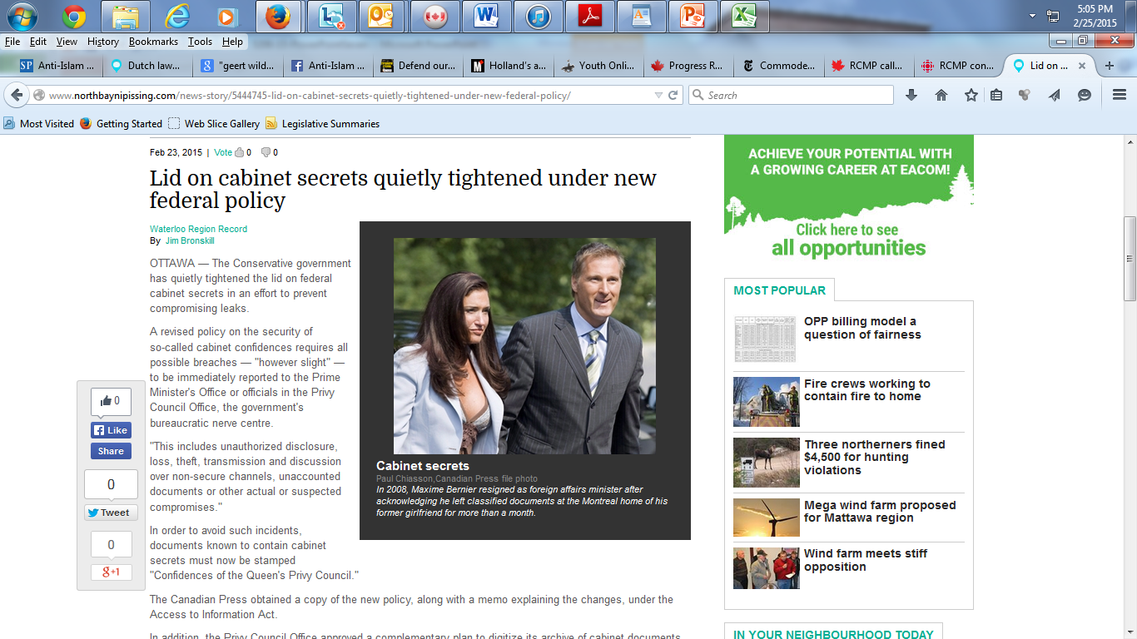

Slide 10
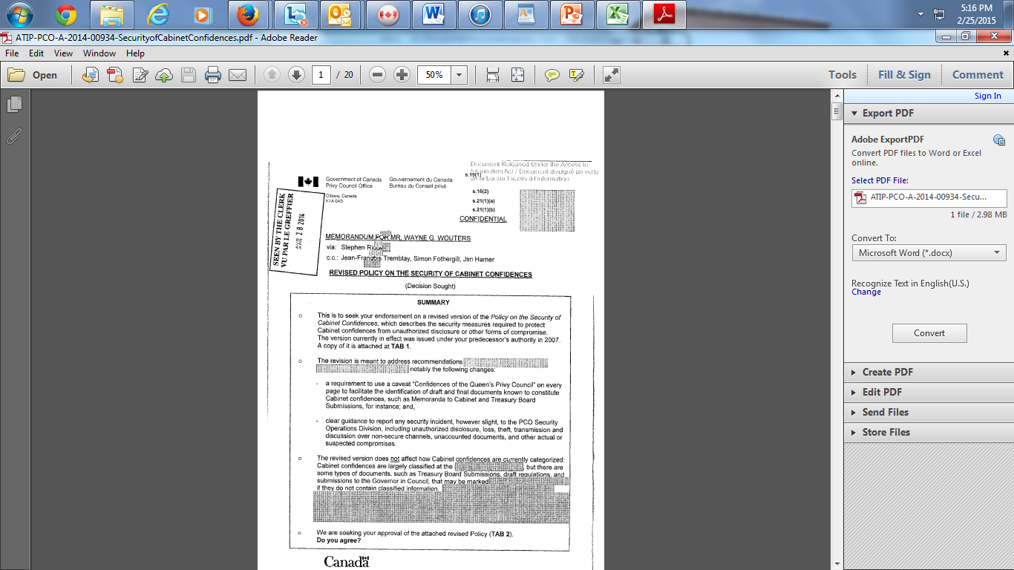

Slide 11
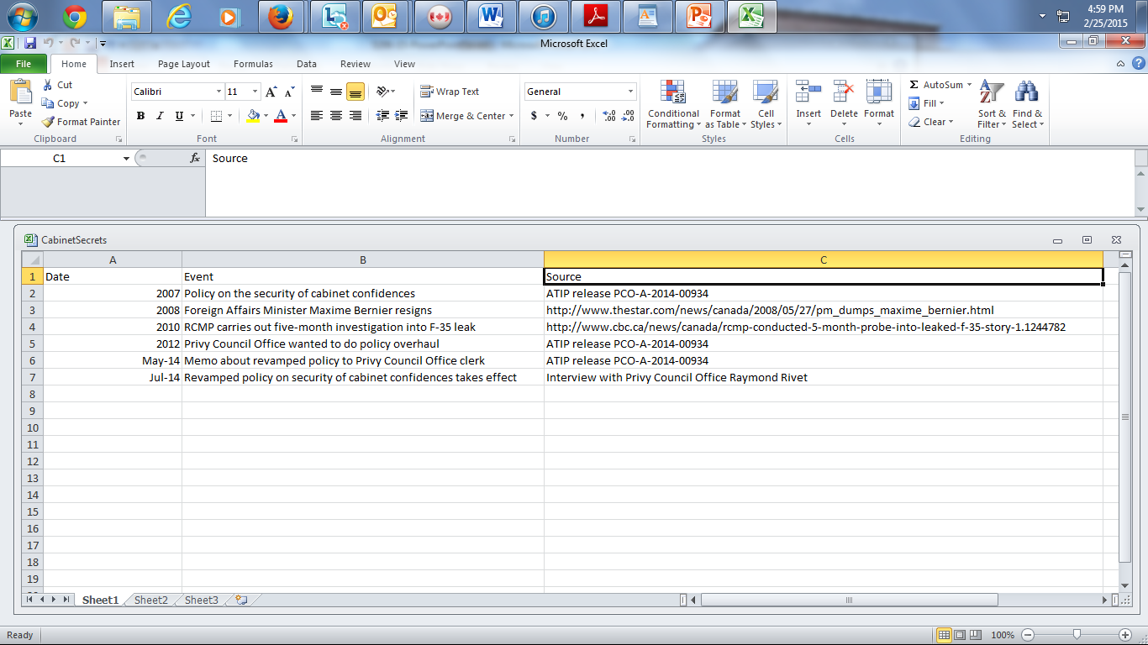

Slide 12
Questions: what’s new?
The new elements of the story should emerge after reviewing your research, notes and chronology
Now you have a basis on which to interview government officials and interested parties about the documents

Slide 13
Interviews
An access release can be a wedge that cracks open a story
It may well prompt a government agency to grant you an interview, even if only fragments of information have been disclosed
In fact, the agency may be eager to put those scraps of material into context. That foot in the door can lead to a wide range of questions

Slide 14
The story process: review
The idea
Research
Questions
Interviews
Sorting
What is the story?
What will help tell the story?
Flow
Fairness
Accuracy

Slide 15
Remember…
You can’t do the assignments for this class at the last minute
Start early
Come up with a lede
Do an outline
If possible, do a draft

