Slide 1
Web Scraping
intro • demo • resources

Slide 2
Why
Yet another way of obtaining data
  Data is not always downloadable
  Data is scattered around webpages
  Data doesn’t exist
  Automate monotonous tasks

Slide 3
Intro
What’s a program
  Websites – HTML • CSS
  Programming Languages – JAVASCRIPT • PYTHON
  Webservers – APIs
  Data – JSON • XML

Slide 4
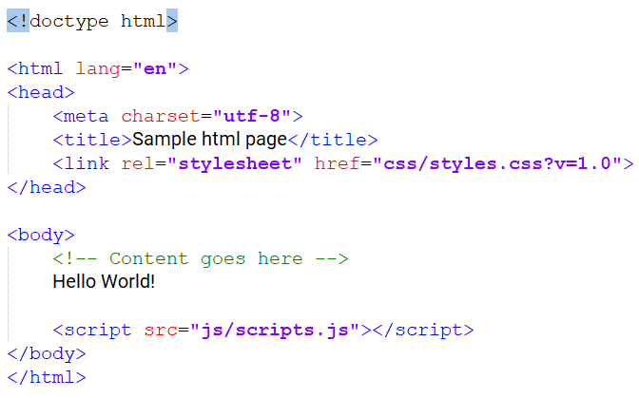
HTML
Hypertext Markup Language
HTML Tags (keywords)
Tag Attributes

Slide 5
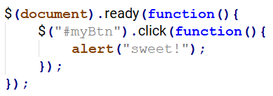
JAVASCRIPT
Complementary to HTML
Interactive Webpages
Dynamic Webpages

Slide 6






Webservers
Remote computers that provide webpages and data
MySQL runs on a server

Slide 7
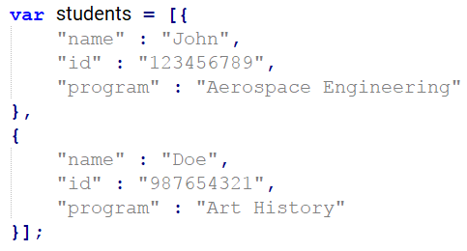
JSON/XML
JavaScript Object Notation
Organised data
Accessible to browsers

Slide 8
‘Demo’
What did I do??
  Gather information about all the course
  Find out how many of these courses require textbooks
  Gather information about the textbooks

Slide 9
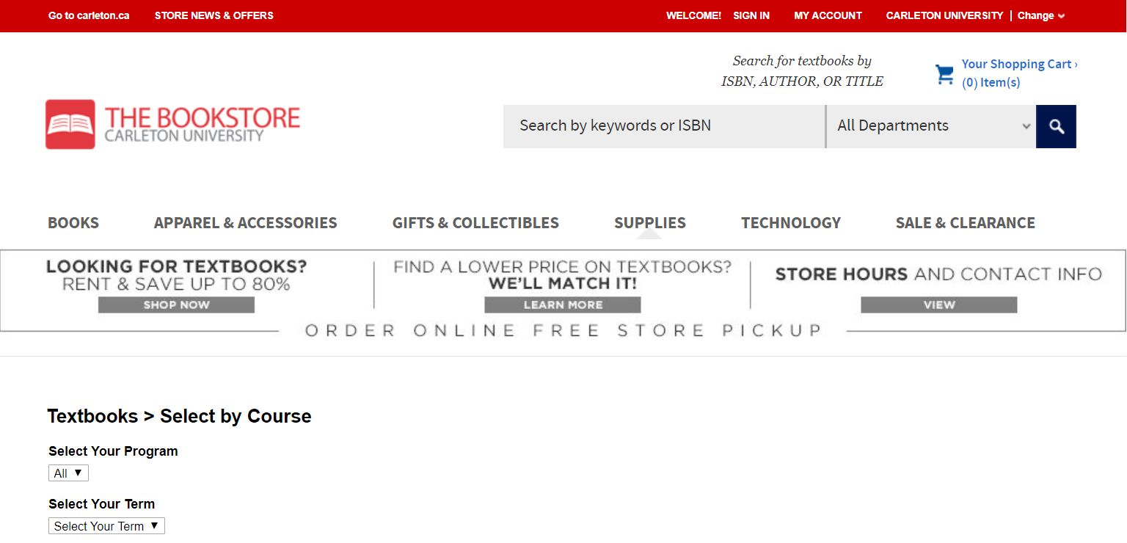
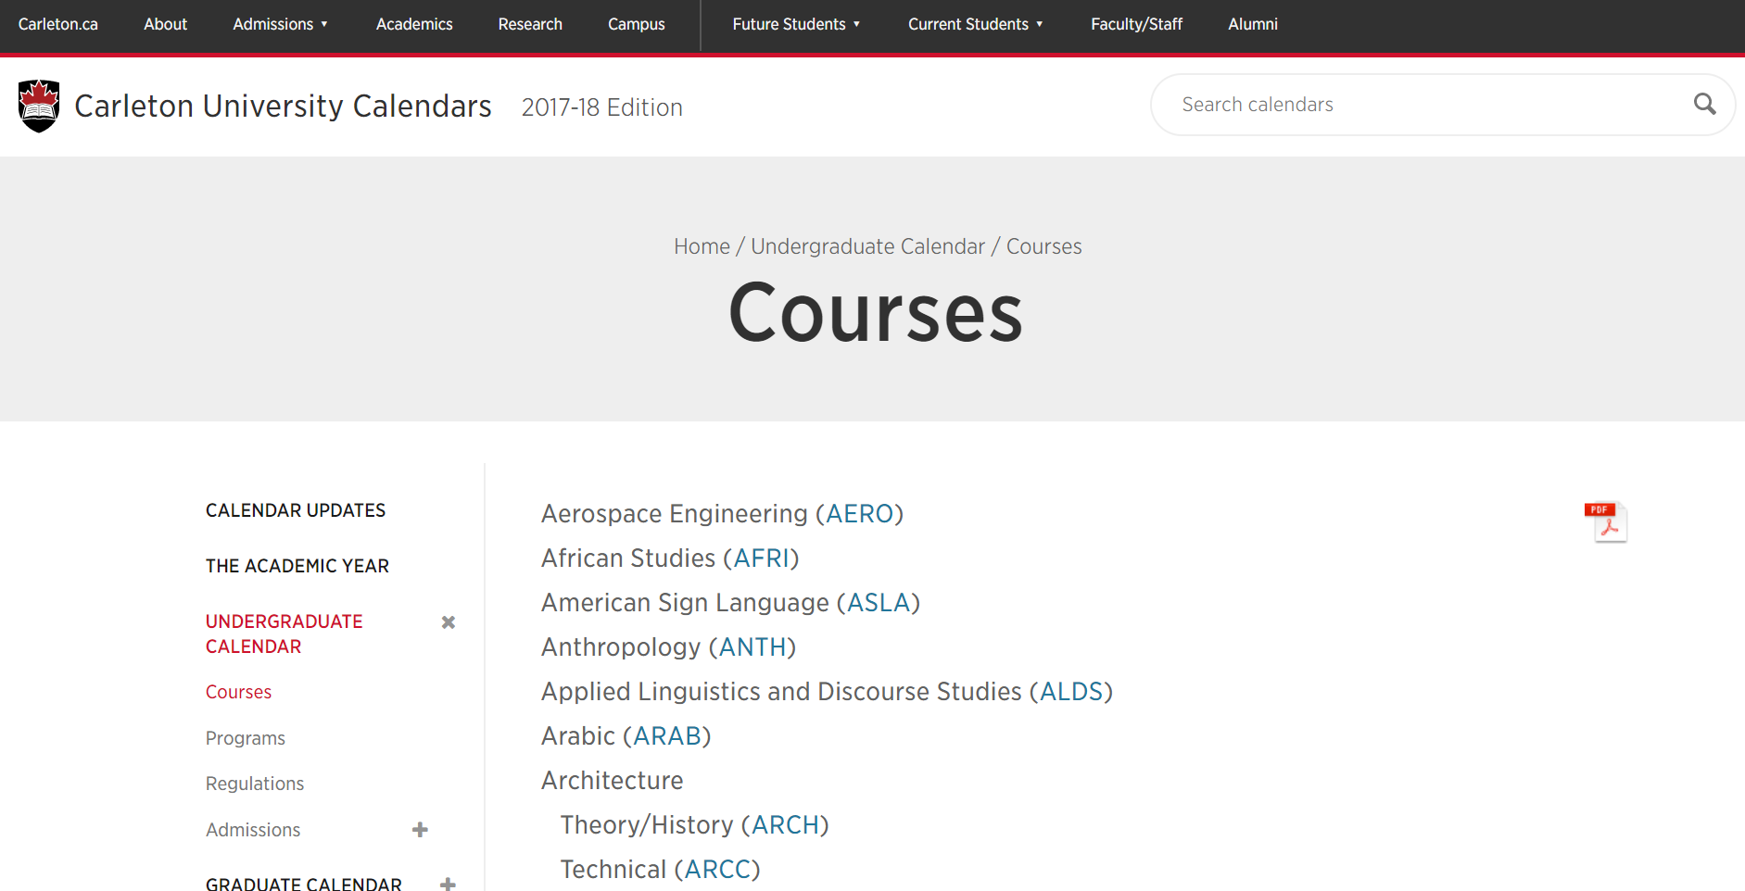
Analyze the websites
  Carleton University
  Bookstore

Slide 10
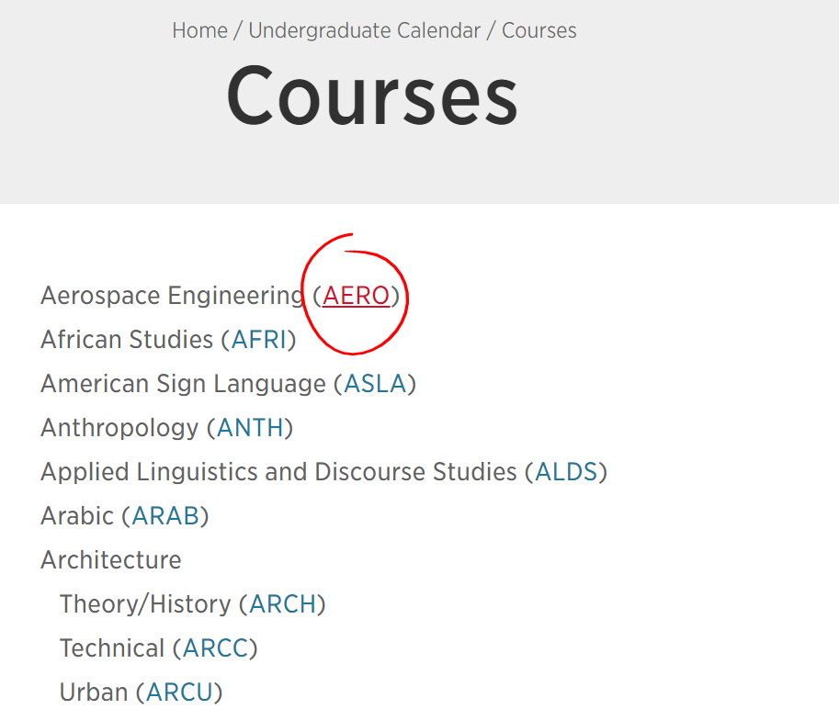
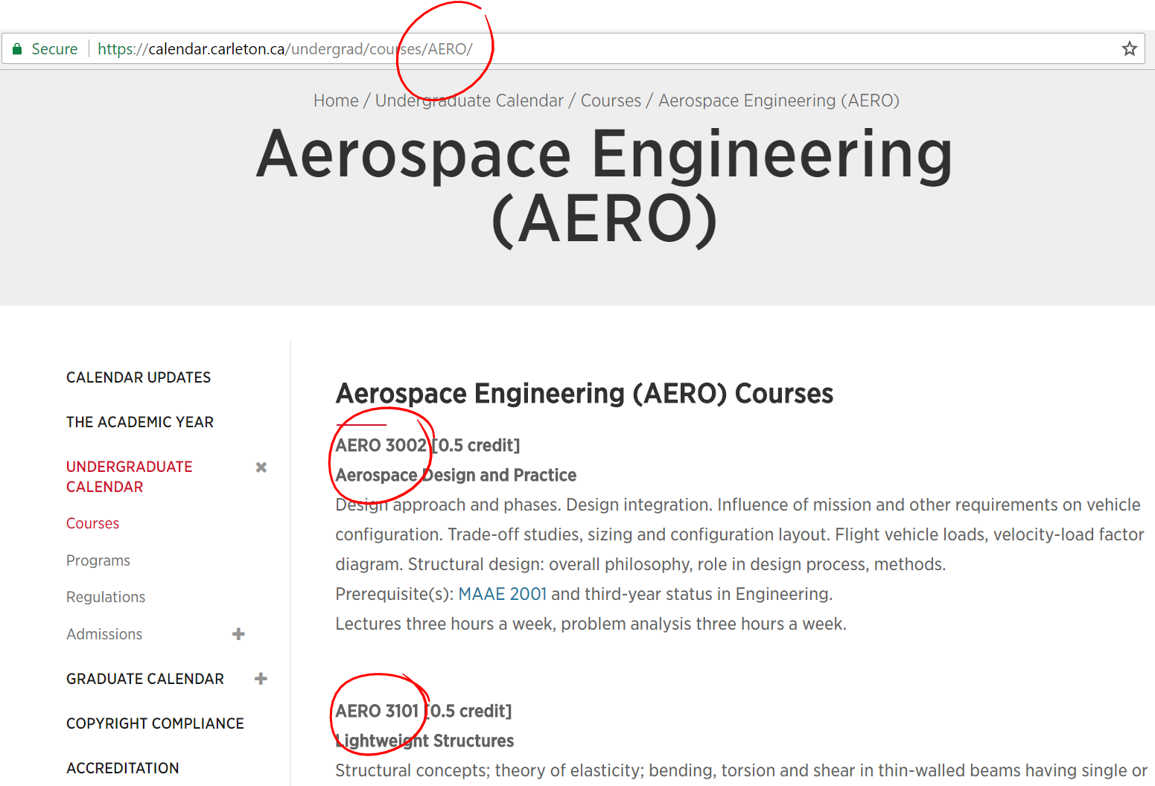

Slide 11
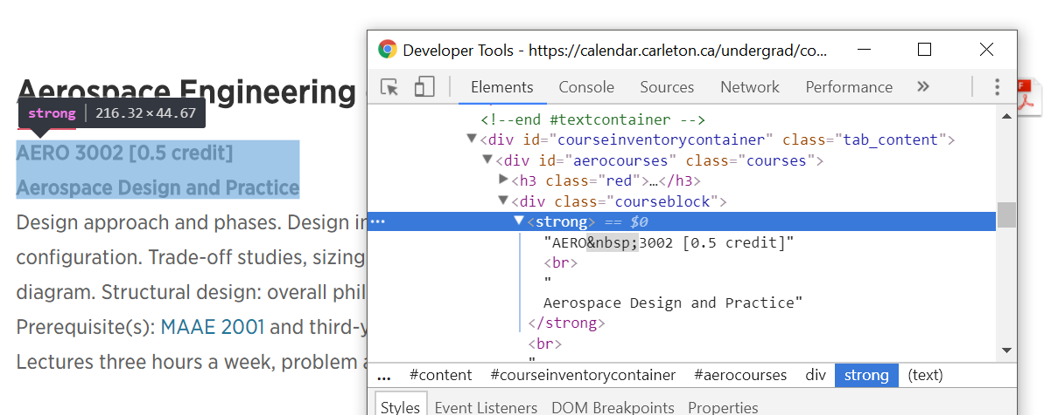

Slide 12
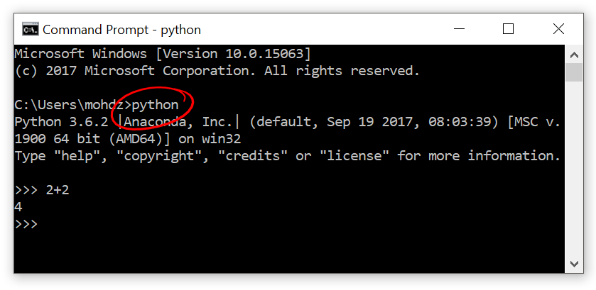
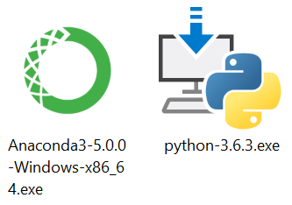
Install python 3.6

Slide 13
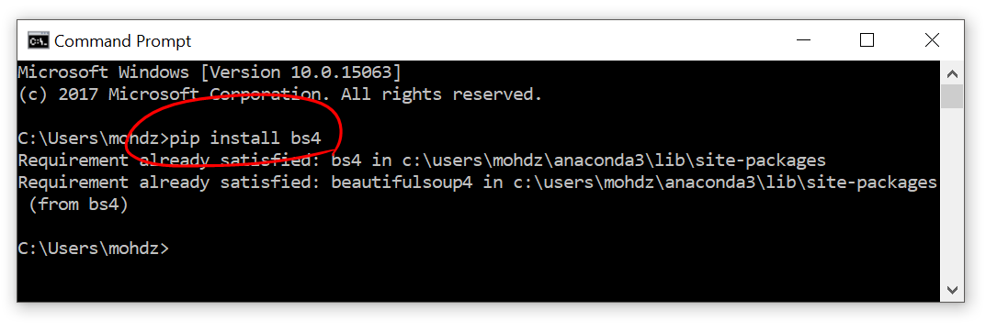
Installing other modules

Slide 14
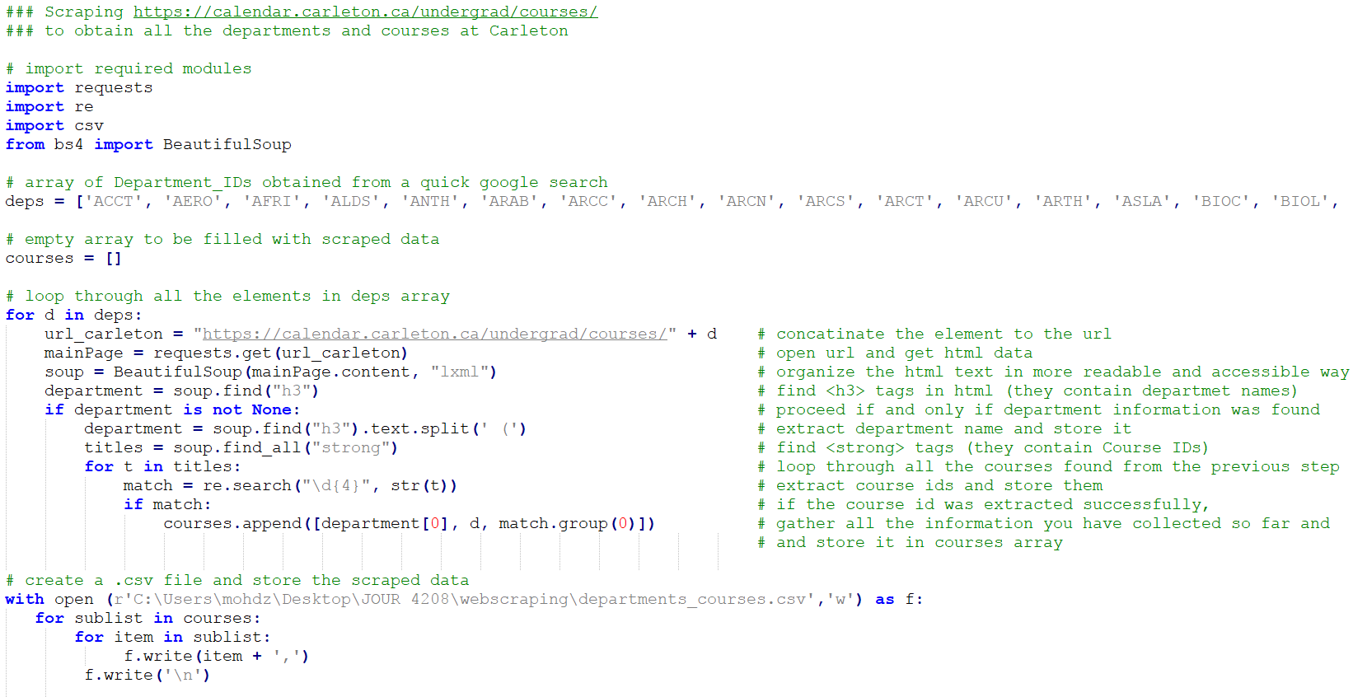

Slide 15
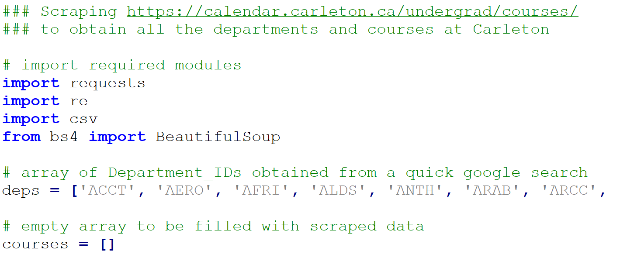

Slide 16
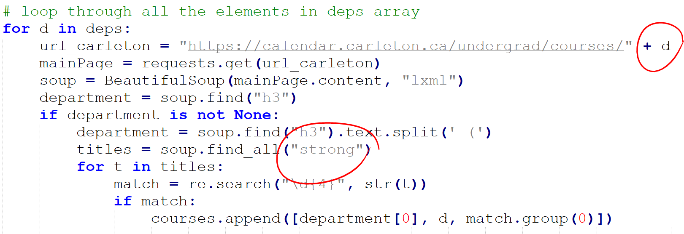

Slide 17
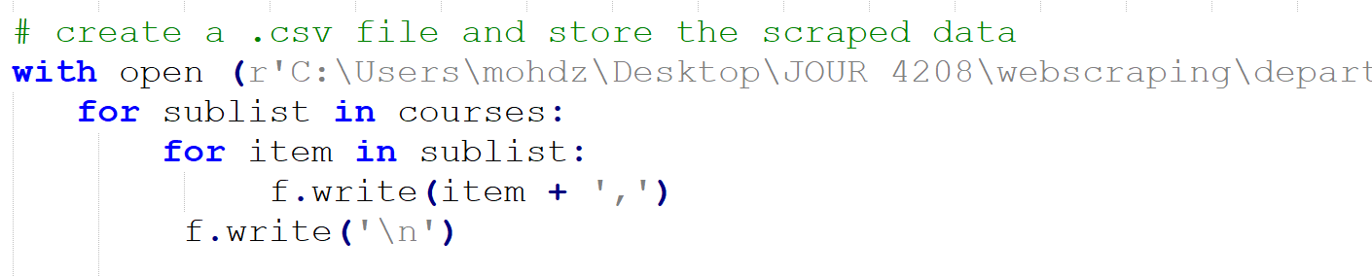

Slide 18
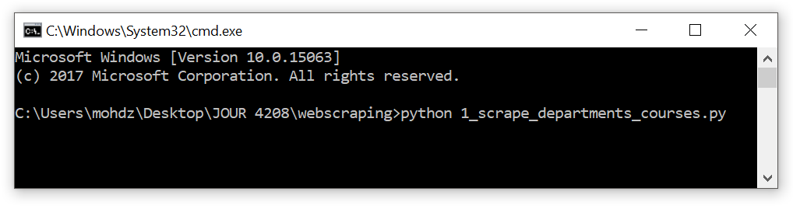

Slide 19
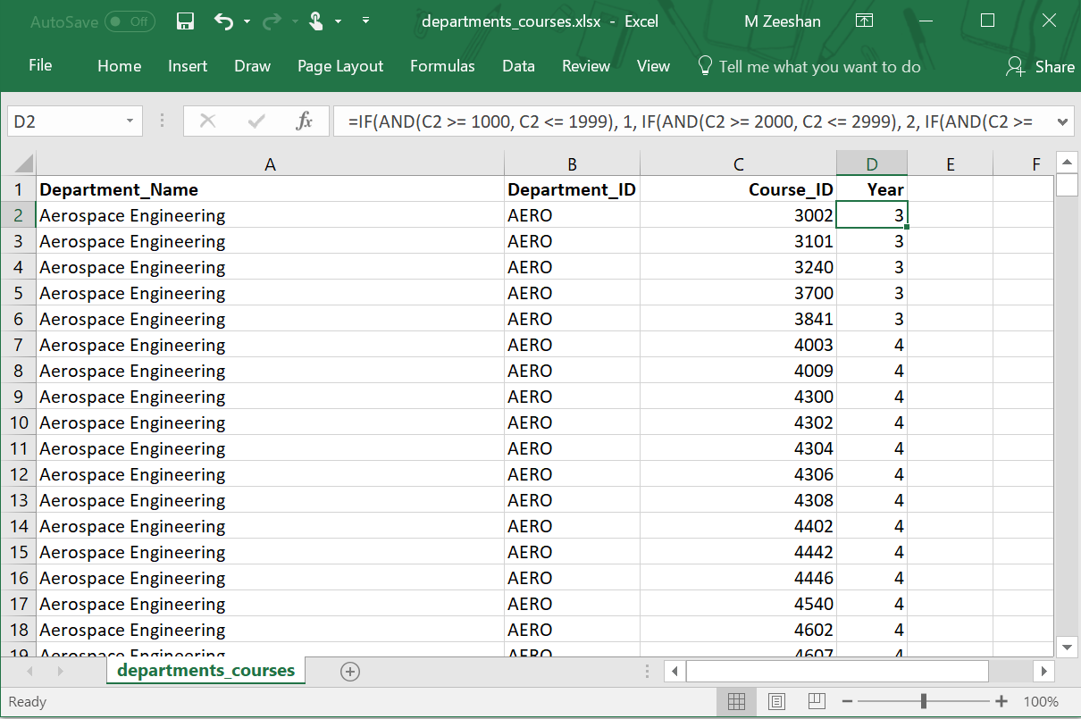
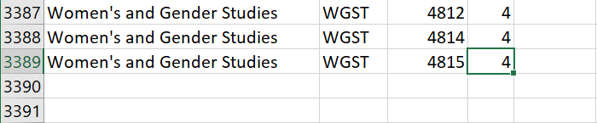

Slide 20
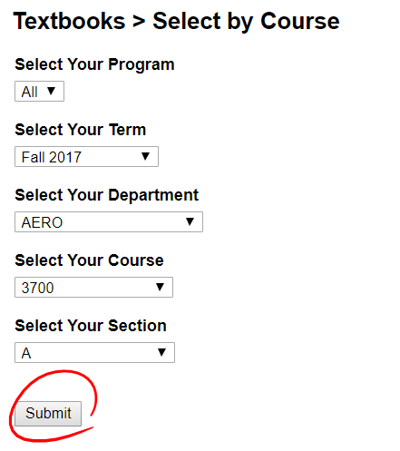
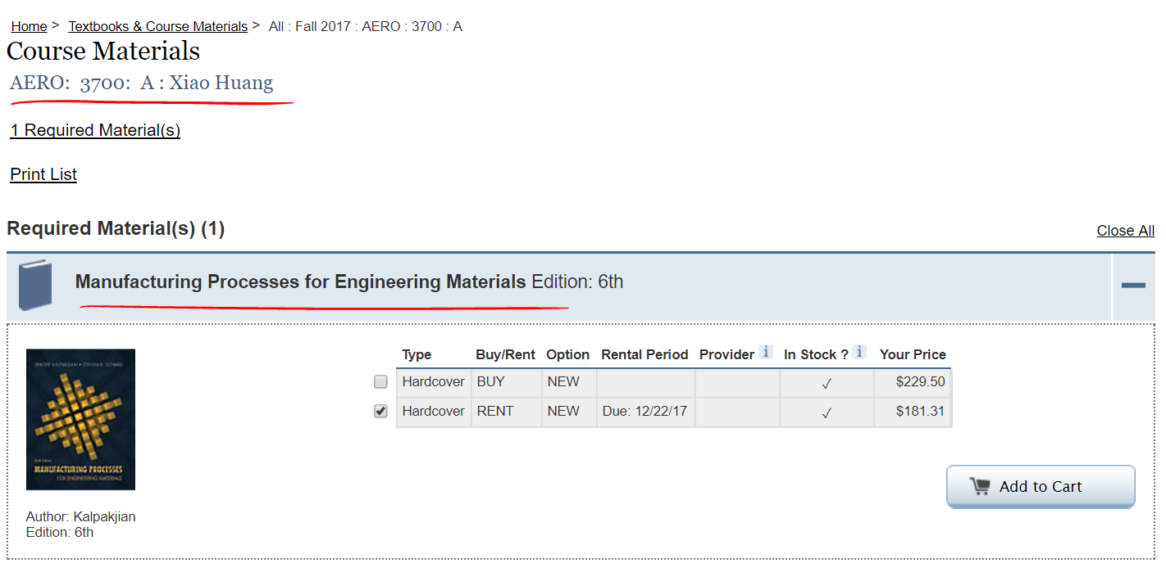

Slide 21
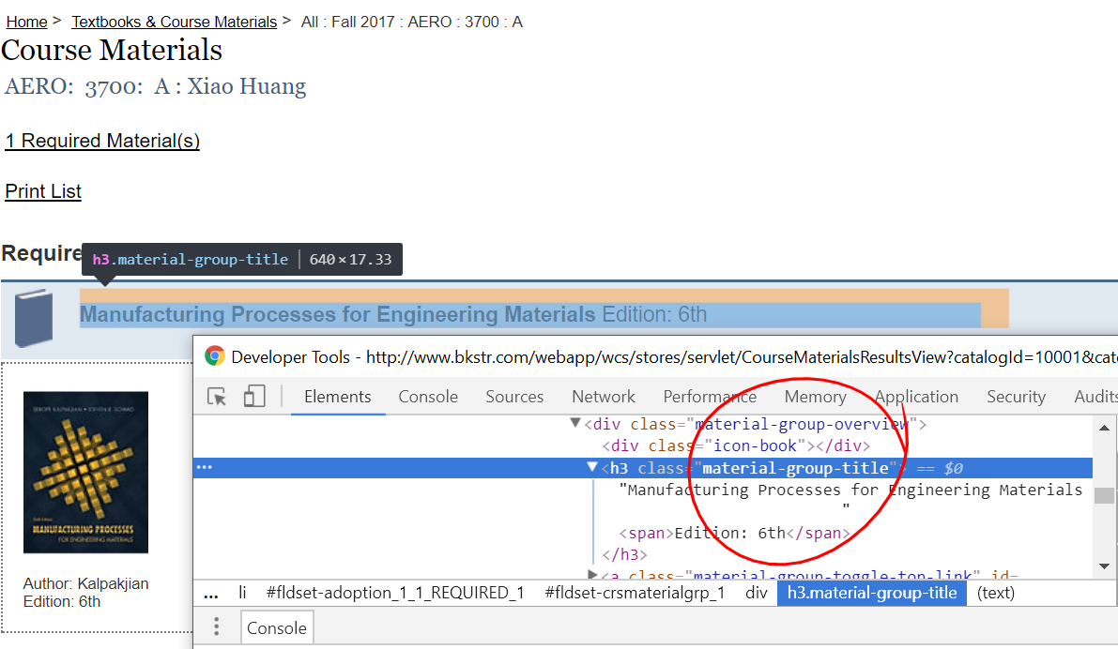

Slide 22
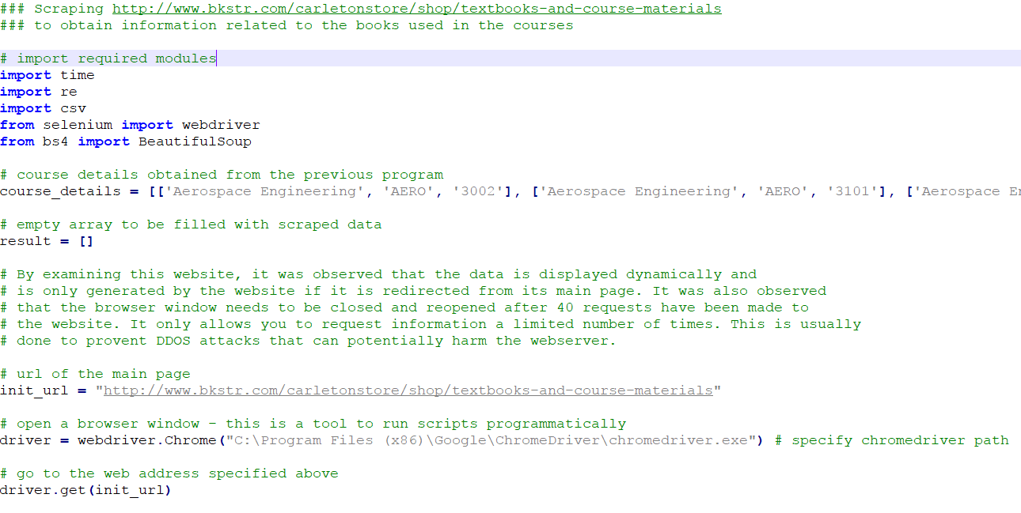

Slide 23
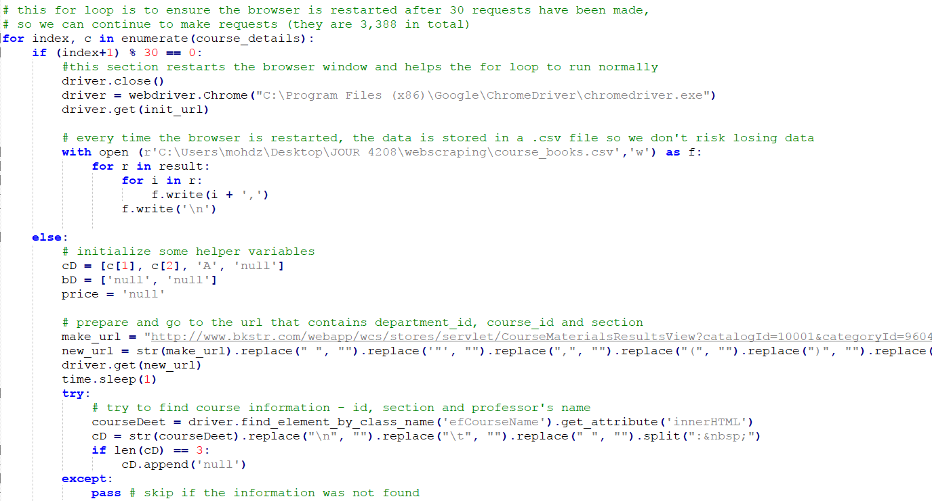

Slide 24
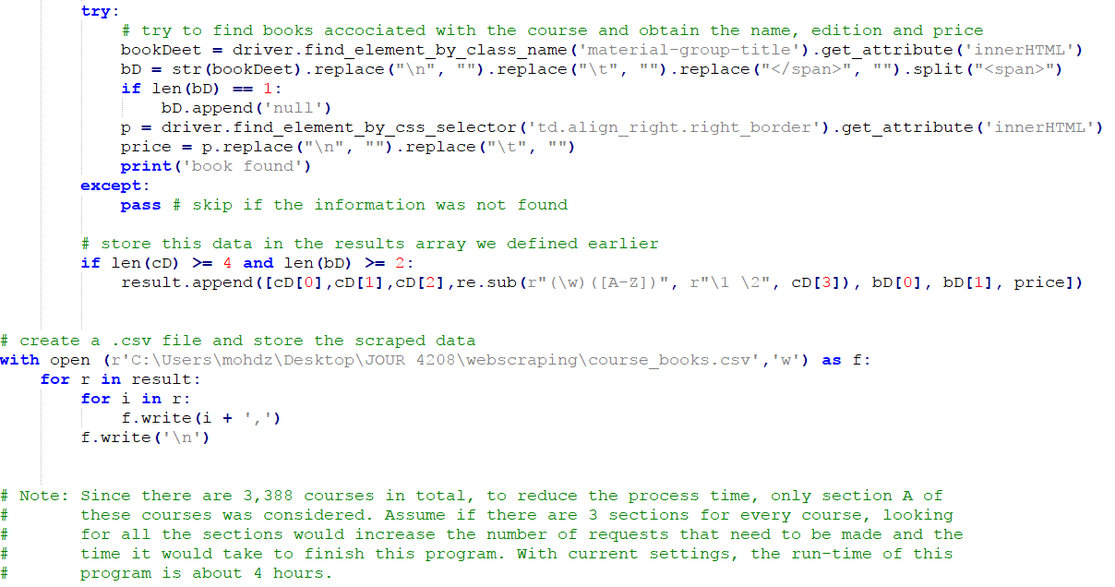

Slide 25
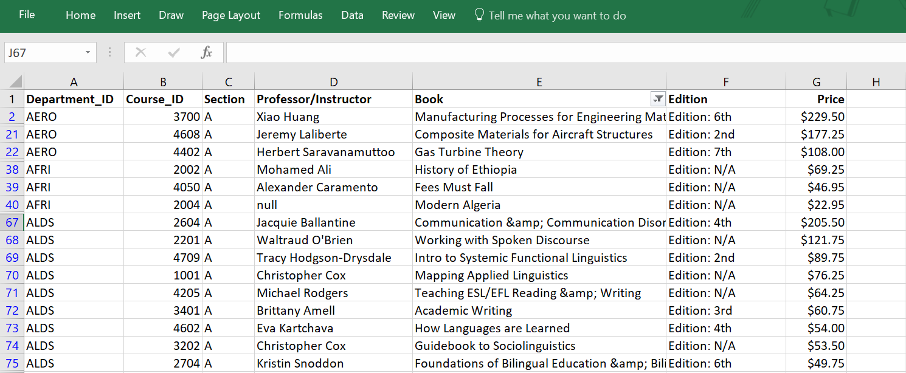
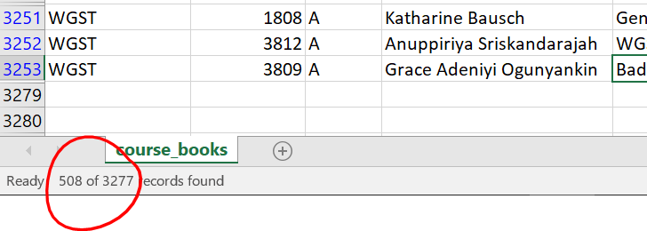

Slide 26
Resources
The Data Journalist – by Fred Vallance-Jones and David McKie
Internet
  Google
  YouTube
  w3schools.com
Other topics to look into
  APIs
  Web development

Slide 27
Ethics
Refer to the book. It’s a good read!

Slide 28
Conclusion
•••

